Slide 1
Unit Introduction
Formed by Our Senses: The Impact of Pornography
on the Individual, Relationships, and Society

Slide 2
Unit Goals
Recognize and experience how we receive information through our senses and how sense perception impacts the understanding of our world and ourselves.
Conduct research on how the use of pornography affects the individual, relationships, and society.
Describe the impacts of pornography
Explain why pornography is harmful using scientific research and insights from Catholic anthropology

Slide 3

Lessons and Objectives
Lesson #1: Popular Understandings of Love
This lesson will give us a greater awareness about what we take in through the media at a subconscious level.
We will also identify dominant cultural ideas about human anthropology by studying the lyrics of popular songs.

Slide 4
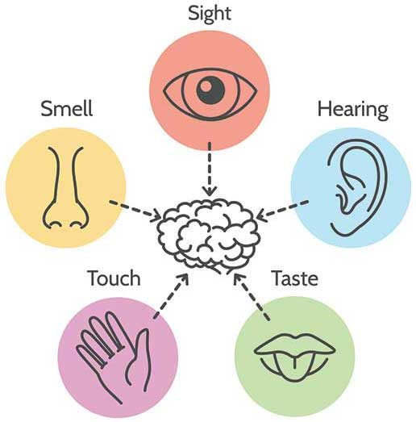
Lessons and Objectives
Lesson #2: Formed by the Senses
In this lesson, we will learn about the role of our five senses in helping us perceive the world around us.
We will also discuss how our sense perception is ordered towards integration. When we experience something with our senses, it affects us on multiple levels.

Slide 5

Lessons and Objectives
Lesson #3: Understanding the Impact of Pornography
This lesson will provide an opportunity for us to study the negative impact pornography has on individuals, relationships, and society at large.
We will also consider where hope might be found in the conversation surrounding pornography.

Slide 6
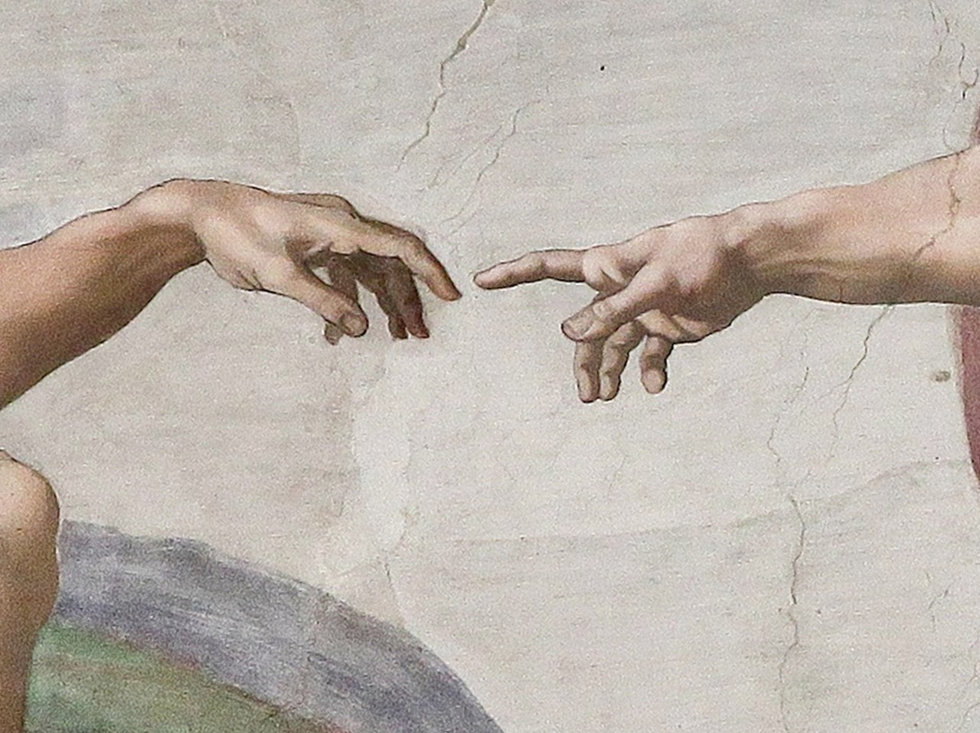
Lessons and Objectives
Lessons #4: Pornography and Catholic Anthropology
In this lesson, we will explore the meaning of St. John Paul II’s statement: “The problem with pornography is not that it shows too much be that it shows to little.”
We will also draw connections between science and theology to better understand the Church’s teaching on pornography.

Slide 7
Lessons and Objectives
Lessons #5: The Problems of Pornography
In this lesson, we will work in groups to identify the numerous problems related to pornography and whether they affect individuals, relationships, and/or society.
We will also recognize that the Catholic Church affirms the these same problems with pornography and offers a holistic vision of the human person.

