Slide 1
Formed by Our Senses
Formed by Our Senses: The Impact of Pornography
on the Individual, Relationships, and Society

Slide 2
READ
LISTEN
WATCH
REFLECT
Based on simply reading the song lyrics, what were your reactions and impressions?
How did you experience the song when you listened to it?
What NEW reactions, impressions, or thoughts surfaced?
How was your experience of the song different from when you simply read the lyrics?
How did you experience the song when you watched the music video?
What NEW reactions, impressions, thoughts surfaced?
How was your experience of the song impacted by the images in the video?
What did the experiences of reading, listening, and watching have in common? What differences did you notice?
What generalizations can you make about the role of the senses in our experience of media (and the world around us)?
Notes:
Depending on the amount of time available for this lesson, the teacher may consider breaking students up into pairs or groups of three based on the option they chose for homework. During the small group discussion students should reflect on the following questions on slides 2-10.
After students have had a generous amount of time (approximately 5-10 minutes) to reflect on these questions, there should be a moment for them to share their insights with the class. This larger class discussion moment may be structured in any number of ways depending on the size of the class, their level of maturity, their rapport with one another and/or with the teacher, and/or their particular skills and needs. The teacher may simply ask each group to share an insight from each question or may choose to have groups visually display their insights. One possible way of doing this is to recreate the categories READ, LISTEN, WATCH, REFLECT on the whiteboard and ask students to jot down words/phrases/short sentences on sticky notes while they discuss the prompts. At the end of the small group discussion time, each group could post their impressions and insights on the board.

Slide 3
READ
LISTEN
WATCH
REFLECT
Based on simply reading the song lyrics, what were your reactions and impressions?
How did you experience the song when you listened to it?
What NEW reactions, impressions, or thoughts surfaced?
How was your experience of the song different from when you simply read the lyrics?
How did you experience the song when you watched the music video?
What NEW reactions, impressions, thoughts surfaced?
How was your experience of the song impacted by the images in the video?
What did the experiences of reading, listening, and watching have in common? What differences did you notice?
What generalizations can you make about the role of the senses in our experience of media (and the world around us)?
Notes:
Depending on the amount of time available for this lesson, the teacher may consider breaking students up into pairs or groups of three based on the option they chose for homework. During the small group discussion students should reflect on the following questions on slides 2-10.
After students have had a generous amount of time (approximately 5-10 minutes) to reflect on these questions, there should be a moment for them to share their insights with the class. This larger class discussion moment may be structured in any number of ways depending on the size of the class, their level of maturity, their rapport with one another and/or with the teacher, and/or their particular skills and needs. The teacher may simply ask each group to share an insight from each question or may choose to have groups visually display their insights. One possible way of doing this is to recreate the categories READ, LISTEN, WATCH, REFLECT on the whiteboard and ask students to jot down words/phrases/short sentences on sticky notes while they discuss the prompts. At the end of the small group discussion time, each group could post their impressions and insights on the board.

Slide 4
READ
LISTEN
WATCH
REFLECT
Based on simply reading the song lyrics, what were your reactions and impressions?
How did you experience the song when you listened to it?
What NEW reactions, impressions, or thoughts surfaced?
How was your experience of the song different from when you simply read the lyrics?
How did you experience the song when you watched the music video?
What NEW reactions, impressions, thoughts surfaced?
How was your experience of the song impacted by the images in the video?
What did the experiences of reading, listening, and watching have in common? What differences did you notice?
What generalizations can you make about the role of the senses in our experience of media (and the world around us)?
Notes:
Depending on the amount of time available for this lesson, the teacher may consider breaking students up into pairs or groups of three based on the option they chose for homework. During the small group discussion students should reflect on the following questions on slides 2-10.
After students have had a generous amount of time (approximately 5-10 minutes) to reflect on these questions, there should be a moment for them to share their insights with the class. This larger class discussion moment may be structured in any number of ways depending on the size of the class, their level of maturity, their rapport with one another and/or with the teacher, and/or their particular skills and needs. The teacher may simply ask each group to share an insight from each question or may choose to have groups visually display their insights. One possible way of doing this is to recreate the categories READ, LISTEN, WATCH, REFLECT on the whiteboard and ask students to jot down words/phrases/short sentences on sticky notes while they discuss the prompts. At the end of the small group discussion time, each group could post their impressions and insights on the board.

Slide 5
READ
LISTEN
WATCH
REFLECT
Based on simply reading the song lyrics, what were your reactions and impressions?
How did you experience the song when you listened to it?
What NEW reactions, impressions, or thoughts surfaced?
How was your experience of the song different from when you simply read the lyrics?
How did you experience the song when you watched the music video?
What NEW reactions, impressions, thoughts surfaced?
How was your experience of the song impacted by the images in the video?
What did the experiences of reading, listening, and watching have in common? What differences did you notice?
What generalizations can you make about the role of the senses in our experience of media (and the world around us)?
Notes:
Depending on the amount of time available for this lesson, the teacher may consider breaking students up into pairs or groups of three based on the option they chose for homework. During the small group discussion students should reflect on the following questions on slides 2-10.
After students have had a generous amount of time (approximately 5-10 minutes) to reflect on these questions, there should be a moment for them to share their insights with the class. This larger class discussion moment may be structured in any number of ways depending on the size of the class, their level of maturity, their rapport with one another and/or with the teacher, and/or their particular skills and needs. The teacher may simply ask each group to share an insight from each question or may choose to have groups visually display their insights. One possible way of doing this is to recreate the categories READ, LISTEN, WATCH, REFLECT on the whiteboard and ask students to jot down words/phrases/short sentences on sticky notes while they discuss the prompts. At the end of the small group discussion time, each group could post their impressions and insights on the board.

Slide 6
READ
LISTEN
WATCH
REFLECT
Based on simply reading the song lyrics, what were your reactions and impressions?
How did you experience the song when you listened to it?
What NEW reactions, impressions, or thoughts surfaced?
How was your experience of the song different from when you simply read the lyrics?
How did you experience the song when you watched the music video?
What NEW reactions, impressions, thoughts surfaced?
How was your experience of the song impacted by the images in the video?
What did the experiences of reading, listening, and watching have in common? What differences did you notice?
What generalizations can you make about the role of the senses in our experience of media (and the world around us)?
Notes:
Depending on the amount of time available for this lesson, the teacher may consider breaking students up into pairs or groups of three based on the option they chose for homework. During the small group discussion students should reflect on the following questions on slides 2-10.
After students have had a generous amount of time (approximately 5-10 minutes) to reflect on these questions, there should be a moment for them to share their insights with the class. This larger class discussion moment may be structured in any number of ways depending on the size of the class, their level of maturity, their rapport with one another and/or with the teacher, and/or their particular skills and needs. The teacher may simply ask each group to share an insight from each question or may choose to have groups visually display their insights. One possible way of doing this is to recreate the categories READ, LISTEN, WATCH, REFLECT on the whiteboard and ask students to jot down words/phrases/short sentences on sticky notes while they discuss the prompts. At the end of the small group discussion time, each group could post their impressions and insights on the board.

Slide 7
READ
LISTEN
WATCH
REFLECT
Based on simply reading the song lyrics, what were your reactions and impressions?
How did you experience the song when you listened to it?
What NEW reactions, impressions, or thoughts surfaced?
How was your experience of the song different from when you simply read the lyrics?
How did you experience the song when you watched the music video?
What NEW reactions, impressions, thoughts surfaced?
How was your experience of the song impacted by the images in the video?
What did the experiences of reading, listening, and watching have in common? What differences did you notice?
What generalizations can you make about the role of the senses in our experience of media (and the world around us)?
Notes:
Depending on the amount of time available for this lesson, the teacher may consider breaking students up into pairs or groups of three based on the option they chose for homework. During the small group discussion students should reflect on the following questions on slides 2-10.
After students have had a generous amount of time (approximately 5-10 minutes) to reflect on these questions, there should be a moment for them to share their insights with the class. This larger class discussion moment may be structured in any number of ways depending on the size of the class, their level of maturity, their rapport with one another and/or with the teacher, and/or their particular skills and needs. The teacher may simply ask each group to share an insight from each question or may choose to have groups visually display their insights. One possible way of doing this is to recreate the categories READ, LISTEN, WATCH, REFLECT on the whiteboard and ask students to jot down words/phrases/short sentences on sticky notes while they discuss the prompts. At the end of the small group discussion time, each group could post their impressions and insights on the board.

Slide 8
READ
LISTEN
WATCH
REFLECT
Based on simply reading the song lyrics, what were your reactions and impressions?
How did you experience the song when you listened to it?
What NEW reactions, impressions, or thoughts surfaced?
How was your experience of the song different from when you simply read the lyrics?
How did you experience the song when you watched the music video?
What NEW reactions, impressions, thoughts surfaced?
How was your experience of the song impacted by the images in the video?
What did the experiences of reading, listening, and watching have in common? What differences did you notice?
What generalizations can you make about the role of the senses in our experience of media (and the world around us)?
Notes:
Depending on the amount of time available for this lesson, the teacher may consider breaking students up into pairs or groups of three based on the option they chose for homework. During the small group discussion students should reflect on the following questions on slides 2-10.
After students have had a generous amount of time (approximately 5-10 minutes) to reflect on these questions, there should be a moment for them to share their insights with the class. This larger class discussion moment may be structured in any number of ways depending on the size of the class, their level of maturity, their rapport with one another and/or with the teacher, and/or their particular skills and needs. The teacher may simply ask each group to share an insight from each question or may choose to have groups visually display their insights. One possible way of doing this is to recreate the categories READ, LISTEN, WATCH, REFLECT on the whiteboard and ask students to jot down words/phrases/short sentences on sticky notes while they discuss the prompts. At the end of the small group discussion time, each group could post their impressions and insights on the board.

Slide 9
READ
LISTEN
WATCH
REFLECT
Based on simply reading the song lyrics, what were your reactions and impressions?
How did you experience the song when you listened to it?
What NEW reactions, impressions, or thoughts surfaced?
How was your experience of the song different from when you simply read the lyrics?
How did you experience the song when you watched the music video?
What NEW reactions, impressions, thoughts surfaced?
How was your experience of the song impacted by the images in the video?
What did the experiences of reading, listening, and watching have in common? What differences did you notice?
What generalizations can you make about the role of the senses in our experience of media (and the world around us)?
Notes:
Depending on the amount of time available for this lesson, the teacher may consider breaking students up into pairs or groups of three based on the option they chose for homework. During the small group discussion students should reflect on the following questions on slides 2-10.
After students have had a generous amount of time (approximately 5-10 minutes) to reflect on these questions, there should be a moment for them to share their insights with the class. This larger class discussion moment may be structured in any number of ways depending on the size of the class, their level of maturity, their rapport with one another and/or with the teacher, and/or their particular skills and needs. The teacher may simply ask each group to share an insight from each question or may choose to have groups visually display their insights. One possible way of doing this is to recreate the categories READ, LISTEN, WATCH, REFLECT on the whiteboard and ask students to jot down words/phrases/short sentences on sticky notes while they discuss the prompts. At the end of the small group discussion time, each group could post their impressions and insights on the board.

Slide 10
READ
LISTEN
WATCH
REFLECT
Based on simply reading the song lyrics, what were your reactions and impressions?
How did you experience the song when you listened to it?
What NEW reactions, impressions, or thoughts surfaced?
How was your experience of the song different from when you simply read the lyrics?
How did you experience the song when you watched the music video?
What NEW reactions, impressions, thoughts surfaced?
How was your experience of the song impacted by the images in the video?
What did the experiences of reading, listening, and watching have in common? What differences did you notice?
What generalizations can you make about the role of the senses in our experience of media (and the world around us)?
Notes:
Depending on the amount of time available for this lesson, the teacher may consider breaking students up into pairs or groups of three based on the option they chose for homework. During the small group discussion students should reflect on the following questions on slides 2-10.
After students have had a generous amount of time (approximately 5-10 minutes) to reflect on these questions, there should be a moment for them to share their insights with the class. This larger class discussion moment may be structured in any number of ways depending on the size of the class, their level of maturity, their rapport with one another and/or with the teacher, and/or their particular skills and needs. The teacher may simply ask each group to share an insight from each question or may choose to have groups visually display their insights. One possible way of doing this is to recreate the categories READ, LISTEN, WATCH, REFLECT on the whiteboard and ask students to jot down words/phrases/short sentences on sticky notes while they discuss the prompts. At the end of the small group discussion time, each group could post their impressions and insights on the board.

Slide 11
“You are what you eat!”
What do people mean by this? Do you agree with this statement?
Notes:
After completing the opening activity (see directions on Slide #2), the teacher will want to transition to the powerpoint content: ex. “We’ve talked a little bit about how things outside of our bodies make their way into the body. So let’s start with a pretty straightforward, simple example of something we think about a lot of the time: food. You’ve all probably heard this phrase before, “You are what you eat! What do you think the meaning of this aphorism is? What do people mean when they say it?”
Give students some time to respond, and then follow-up with the question, “Do you agree with this statement?” Hopefully students will readily see and articulate that what we eat affects our health, our energy, etc. But if they’re struggling with the question the teacher might ask them how their bodies feel if they eat junk food all day long as opposed to nourishing meals. There is also interesting research that suggests that what we eat affects more than our physical health; it affects our mental health, too. The teacher might mention some the research from Harvard University that suggests a connection between diet and depression: Gut Feelings: How Food Affects Your Mood.

Slide 12

“You are what you eat!”
We know that what we consume can impact our energy level, ability to focus, risk of health complications, and even our relationships.
Notes:
What would happen if you only ate cheeseburgers? Play part or all of the video from TLC’s “Freaky Eaters” which tells the story of Victor, a man addicted to eating cheeseburgers. The video shows the number of cheeseburgers he’s consumed in a year. His addiction is leading to serious health concerns, including diabetes, but also to relationship issues, etc.
Short version: https://www.youtube.com/watch?v=cJ4di4_U6Ks
Longer version: https://www.youtube.com/watch?v=A-8xJfKFKaE&t=4s
While it’s not absolutely necessary to show the video, it is a good illustration of the extent to which what one eats affects not only one’s health but also one’s relationships. If pressed for time, the teacher could simply describe the video contents. The key point of this example is to expand students’ horizon of thinking from the individual consequences of one’s actions to their effect on other people in one’s life. In their initial responses to the aphorism, “You are what you eat!” students will likely focus on the health of the individual; now, the teacher has the opportunity to draw out the insight that what we do, in Victor’s case only eating cheeseburgers, actually impacts others. This example gives students the chance to think about how the individual person is not just his or her body, but also a person in relationship with others (to use theological terms, human beings are being in communion with others).

Slide 13
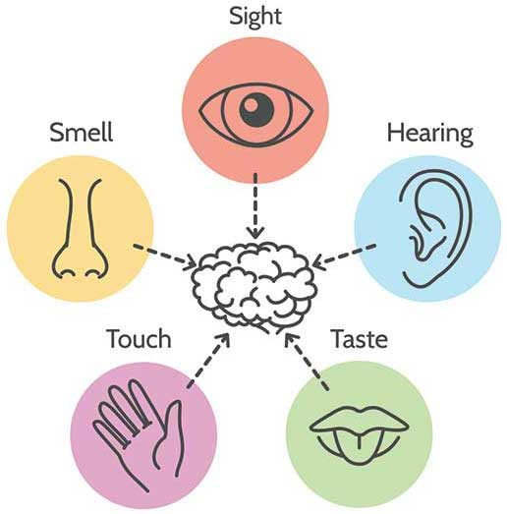
“You are what you consume!”
We are impacted by more than what we eat.
Notes:
Now, the teacher will want to broaden the conversation: “We’ve seen how Victor’s consumption of cheeseburgers affects not only his health, but also his relationship with his wife. When we talk about eating, we often use the word, ‘consuming.’ But we also use this word to describe other ways we take in the world around us. Other than eating, how else do you consume the world around you?” The following slides break open specific examples for each mode of sense perception, but it’s important to allow students begin to think and share about it before moving on.

Slide 14
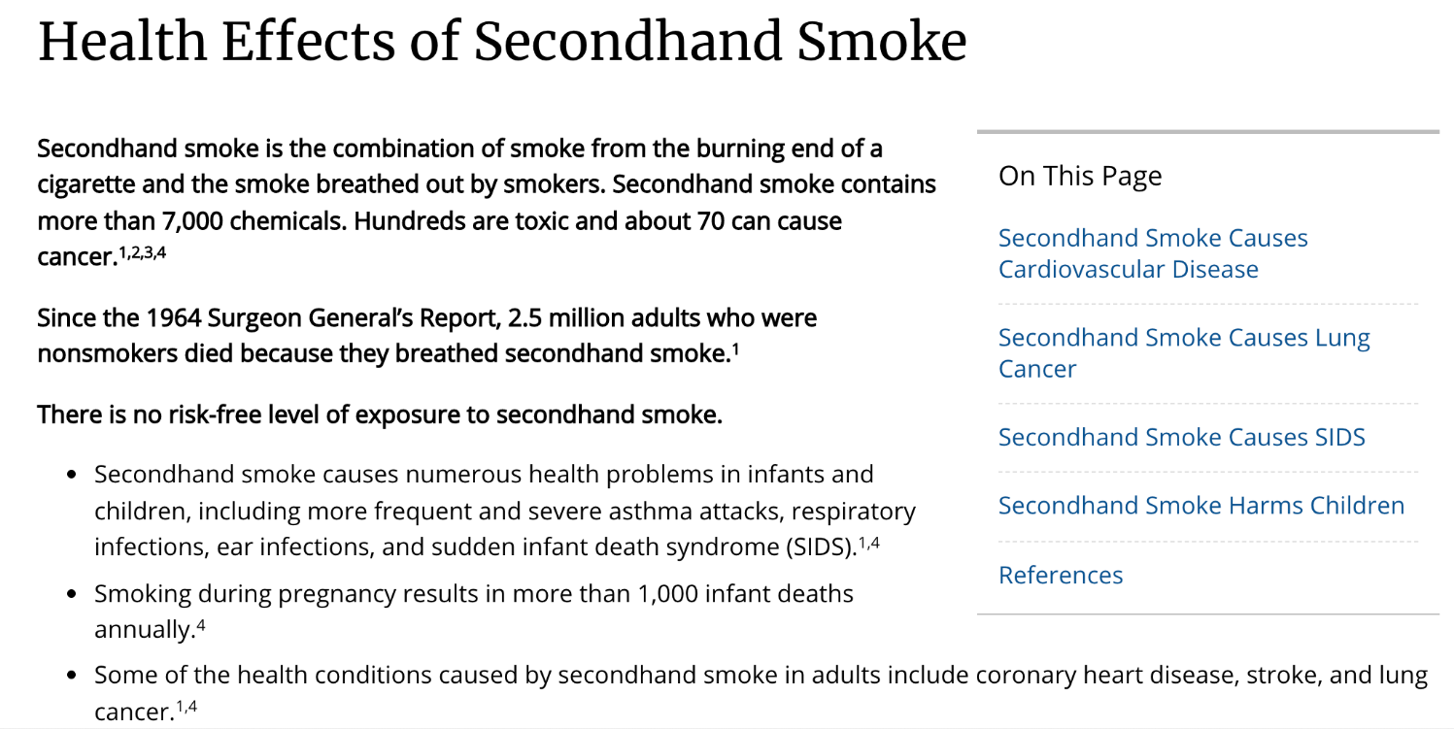
SMELL
Notes:
The primary purpose of the next several slides is to illustrate how we “consume” (i.e. take in the world around us) using our other five senses. The teacher may expand the examples provided to note the distinction between active and passive forms of consumption. For example, in the discussion about secondhand smoke, the teacher might point out that the person who smokes is choosing (at some level) to take those toxins into his or her body, but a child, say, who is exposed to secondhand smoke isn’t making a choice to be exposed to smoke, but is still affected by it.
https://www.cdc.gov/tobacco/data_statistics/fact_sheets/secondhand_smoke/health_effects/index.htm

Slide 15

TOUCH
Notes:
One example of physical touch the teacher might offer is the importance of skin-to-skin contact after birth. It’s really important for babies to have skin-to-skin contact with their mothers and fathers because this affects everything from the newborn’s heartbeat and breathing, to brain development, and bonding between the new parents and the child. Skin to skin contact doesn’t just affect us physically.
https://news.sanfordhealth.org/childrens/the-importance-of-skin-to-skin-after-delivery-you-should-know/

Slide 16
TOUCH
For Baby
For Mother
Better able to absorb and digest nutrients
Better body temperature maintenance
Cries less often
Demonstrate improved weight gain
Experience more stable heartbeat and breathing
Higher blood oxygen levels
Improved brain development and parental attachment
Stronger immune system
Spend increased time in the very important deep sleep and quiet alert states
Experience more positive breastfeeding
Improved breast milk production
Likely to have reduced postpartum bleeding and lower risk of postpartum depression
Notes:
Some additional positive effects of skin-to-skin for mother and baby.
https://news.sanfordhealth.org/childrens/the-importance-of-skin-to-skin-after-delivery-you-should-know/

Slide 17
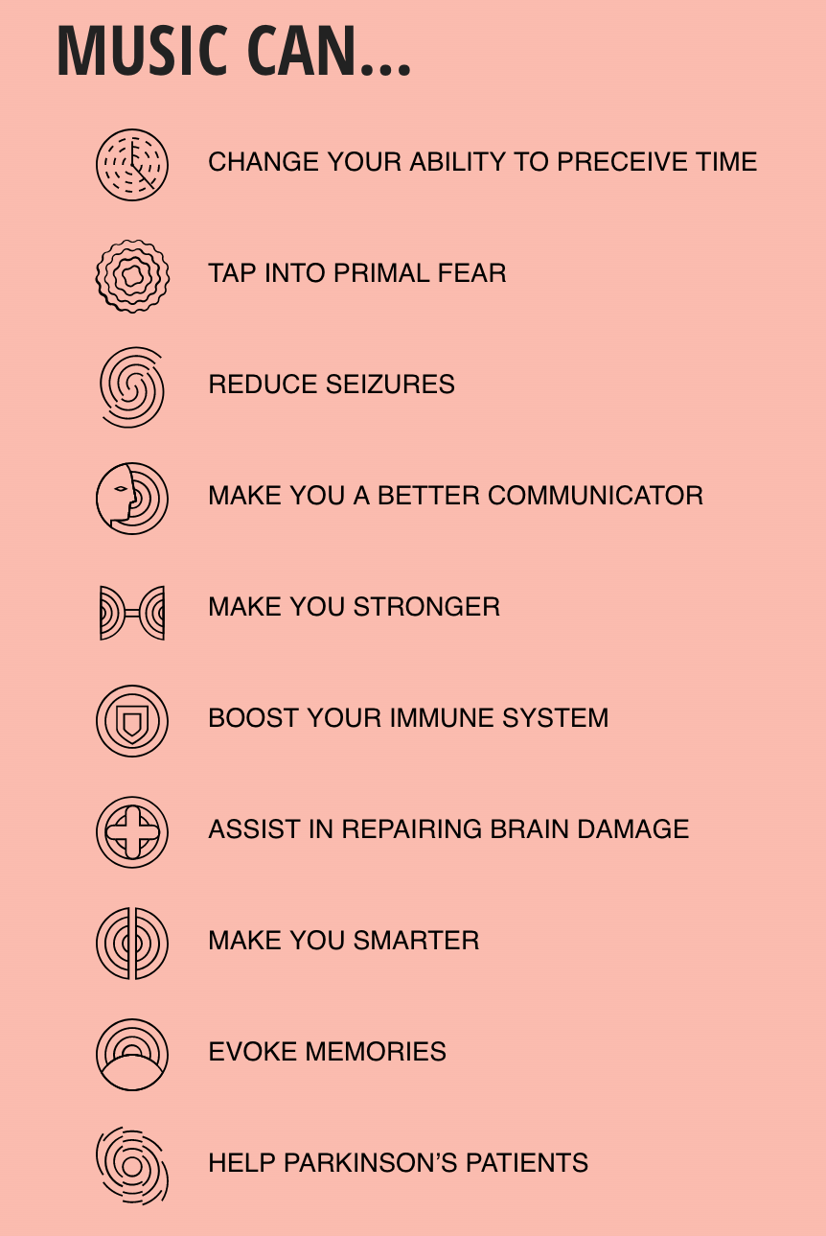
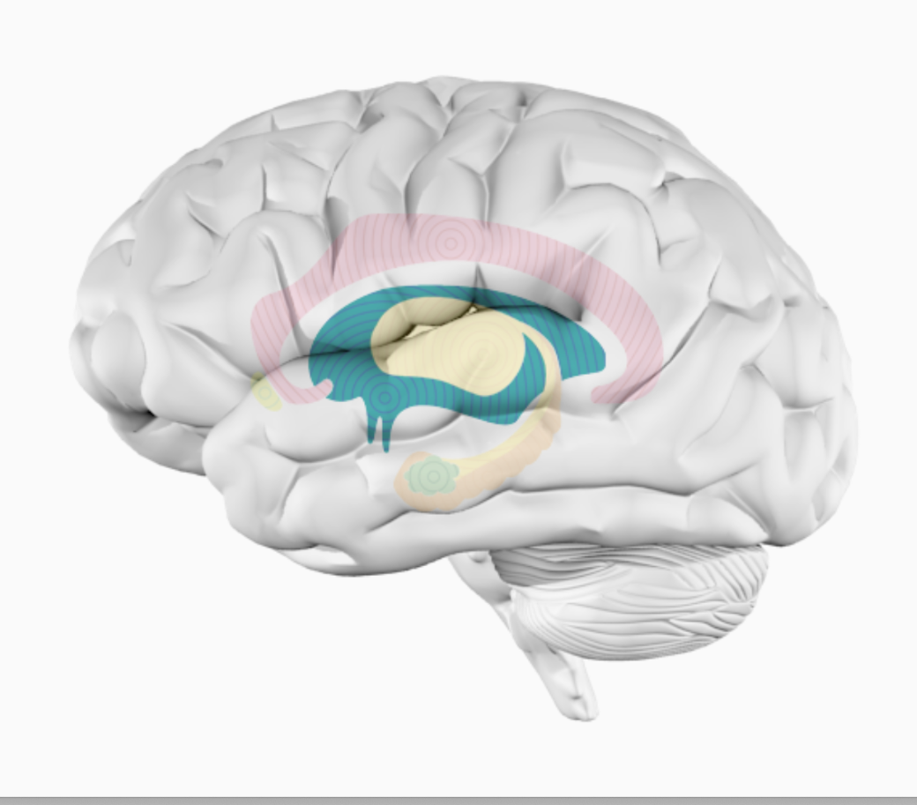
HEARING
Notes:
Colored area indicates music’s impact on the part of the brain called the hypothalamus which “produces and releases essential hormones and chemicals that regulate thirst, appetite, sleep, mood, heart rate, body temperature, metabolism, growth, and sex drive - to name just a few.”
“If you play Mozart, for example, ‘heart rate and blood pressure reduce,’ Sugaya says.”
https://www.ucf.edu/pegasus/your-brain-on-music/

Slide 18
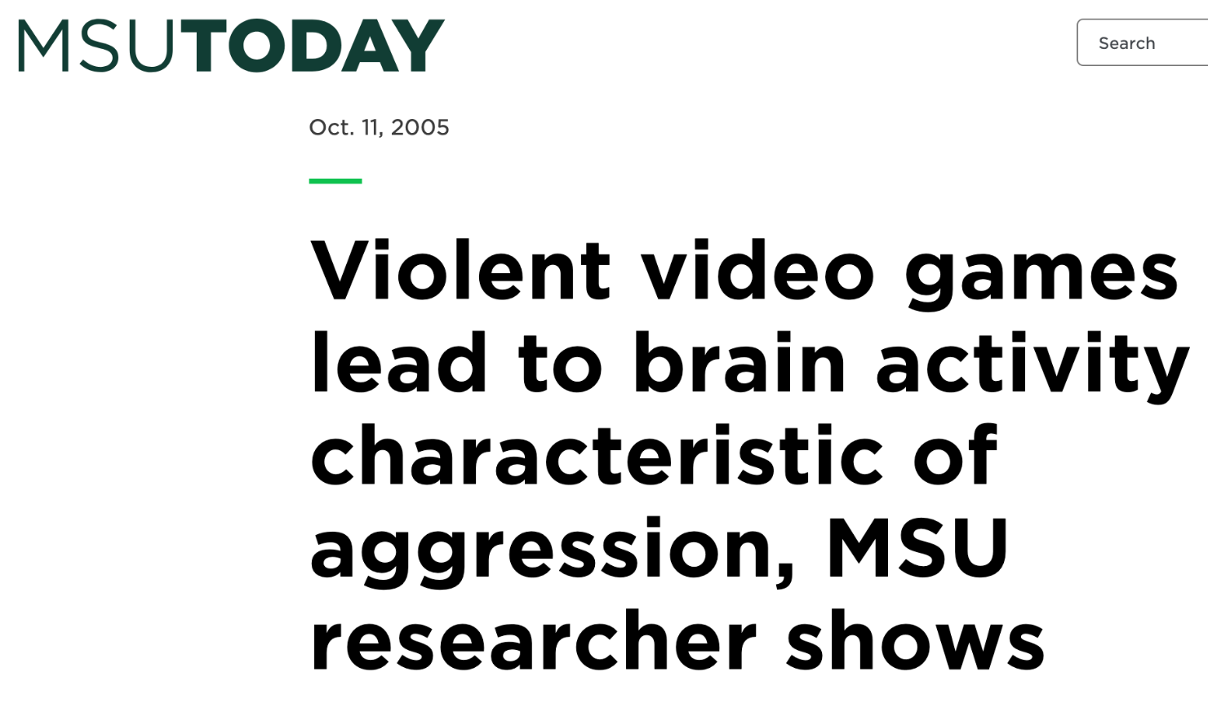
SIGHT
Notes:
https://msutoday.msu.edu/news/2005/violent-video-games-lead-to-brain-activity-characteristic-of-aggression-msu-researcher-shows

Slide 19
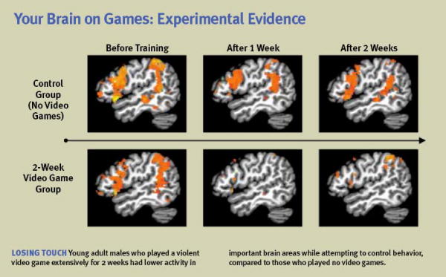
Notes:
Since the text at the bottom of the slide is quite small, the teacher should be sure to explain to students what they’re looking at on this slide. The colored regions show the brain activity around areas that control behavior. In the control group on the top (people who did not play video games) there is a lot of color in the regions that control behavior, In the video game-playing group who there is much less color, indicating that those who played violent video games showed a decreased ability to control their behavior, impulses, which can lead to more erratic and aggressive behavior. The teacher could also mention the effect of social media on mental health.
https://www.brainandlife.org/articles/how-do-video-games-affect-the-developing-brains-of-children

Slide 20
Were you familiar with any of these studies already?
What surprised you the most?
Notes:
The teacher will want to engage the students in discussing these studies. When possible, it will be helpful to emphasizes the effects that consumption has on the individual (in different ways- emphasizing the integrated nature of a human being across the physical, social, emotional, psychological, intellectual and spiritual dimensions) and also the potential effects on relationships with others.

Slide 21
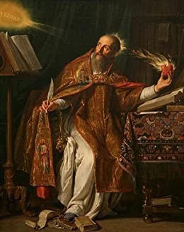
TASTE
“Behold who you are,
become what you receive!”
St. Augustine, sermon on the Eucharist
Notes:
In the Eucharist, we receive the Body of Jesus into our own bodies. THIS IS AN EXAMPLE OF THE PENTULTIMATE CONSUMPTION; WE EXPERIENCE WHAT WE CONSUME THROUGH ALL OF OUR HUMAN DIMENSIONS (PHYSICAL, SOCIAL, EMOTIONAL, PSYCHOLOGICAL, INTELLECTUAL, AND SPIRITUAL) Through this ACT OF CONSUMPTION, we become members of the Body of Christ, the Church. This identity has a tangible impact on the way we live. When we enter into communion with the Body of Christ, we are equipped, by God’s grace, to serve others as He did, and to draw others into deeper relationship with Him. In the words of St. Teresa of Avila, “Christ has no body but yours, no hands, no feet on earth but yours. Yours are the eyes with which He looks with compassion on this world. Yours are the feet with which He walks to do good. Yours are the hands with which He blesses all the world.”

Slide 22
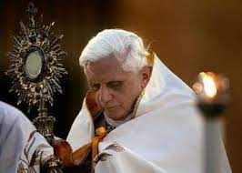
EUCHARIST You are what you eat
“Reception of the Eucharist…is also about allowing ourselves to enter into communion with Christ, and through him with the whole of the Trinity, so as to become what we receive and to live in communion with the Church.”
Pope Benedict XVI, “The Eucharist Is Not a Meal Among Friends”
Notes:
In his homily for the 49th International Eucharistic Congress in 2008, Pope Benedict XVI explains that union with Christ through the Eucharist leads to union with “the whole of the Trinity.” When we receive the Eucharist, God makes His home in us and transforms us so that we can reflect the image of God more clearly.

Slide 23
EUCHARIST You are what you eat
“I am the bread for the strong, eat me! But you will not transform me and make me part of you; rather, I will transform you and make you part of me.”
Jesus to St. Augustine, Confessions
Notes:
In commenting on a mystical experience of St. Augustine, Benedict XVI explains, “In the normal process of eating, the human is the stronger being. He takes things in, and they are assimilated into him, so that they become part of his own substance…But in the mutual relation with Christ it is the other way around…When we truly communicate [receive communion], this means that we are taken out of ourselves, that we are assimilated into him, that we become one with him” (God is Near Us).
IMPORTANT NOTE: Students may naturally wonder how they are changed by receiving the Eucharist if they don't necessarily feel any different after receiving communion. They may not express this question out loud in class, so it will be beneficial for the teacher to broach the topic. The teacher might explain how reception of the Eucharist gradually transforms us to become more like Christ by way of analogy. After reading a book, we don't necessarily feel much smarter, but over time, the habit of reading strengthens the mind. Immediately after exercising, we might not feel much stronger, but over time, the habit of exercise strengthens the body. After a conversation with a friend, we may not feel significantly closer to them, but over time, frequent conversation draws friends closer to one another. Similarly, the more we receive the Eucharist, the more we will notice how we are being drawn into deeper intimacy with Christ.

Slide 24
In Conclusion
We are impacted physically and spiritually by what we take in through our senses.
Remember the “Evaluating Song Lyrics” Activity?
  What we listen to affects how we think about relationships and how we relate to others.
Remember the “Read, Listen, Watch” Activity?
  When more than one of our senses are engaged, the impact of the media we’re consuming is more powerful.
In the next lesson, we will take a closer look at the impact pornography can have on its viewers.
Notes:
Our senses help us to take in the world around us. Because we, as human beings, are both bodies and souls, what we consume will impact us on multiple levels. For example, the food we eat affects us physically, but it can also impact our relationships, as well as our emotional and psychological health. In a similar way, our consumption of the Eucharist impacts us on multiple levels, allowing God to transform us into Himself.
In the next lesson, we will consider the impact that pornography consumption has on its viewers, those within the porn industry, and on the world at large.

