Slide 1
Moral Considerations of China’s One-Child Policy
Exploring China’s One-Child Policy

Slide 2
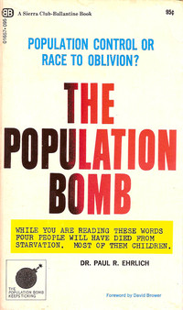
Historical Context of China’s One-Child Policy
The Population Bomb by Paul Ehrlich published in 1968
Predicated famines, food shortages, mass starvation and destruction within a decade (~1979)
Target: zero-population growth
Encouraged people to have fewer and “better” children
Assumed the need for compulsory public policies to ensure zero-population growth.
Notes:
Teacher Notes: Before examining the ethical issues in more detail, the teacher will want to review the historical context surrounding the Chinese government’s decision to enact the one-child policy. There are several points to make here:
(1) Fears of over-population gripped the world throughout the 1960s, 1970s, and beyond. In 1968, Paul Ehrlich published the book The Population Bomb, which sold over 2 million copies. Ehrlich’s argument was essentially that the planet’s resources are finite (i.e., not unlimited) and so continued population growth would deplete the planet’s limited resources. In his book, Ehrlich predicted that before the end of 20th century, or even possibly within a decade, many parts of the world would face severe food shortages and mass starvation because of overpopulation. He urged countries to commit to “zero-population growth.” This meant that a country’s population would not increase. As students heard in the short PBS Report at the beginning of this unit, Paul Ehrlich recommended compulsory enforcement of population control policies if voluntary methods (such as voluntary birth control) failed, such as a tax on children or treating public water to make men and women less fertile. Many governments around the world assumed they needed to adopt mandatory public policies to ensure that their populations would not grow. Often this meant targeting the poor and disenfranchised because governments and wealthy citizens promoted the idea that poverty was the result of too many children rather than unfair and unequal economic systems.
In 1970, Ehrlich predicted that in the next 15 years the world would completely break down and be unable to support human life. Ehrlich's theory did not take into account the human capacity for innovation, which is precisely what happened. The “green revolution” introduced new farming technologies that enabled countries to feed their growing populations. Even though Ehrlich’s theory turned out to be wrong, it had worldwide influence.

Slide 3
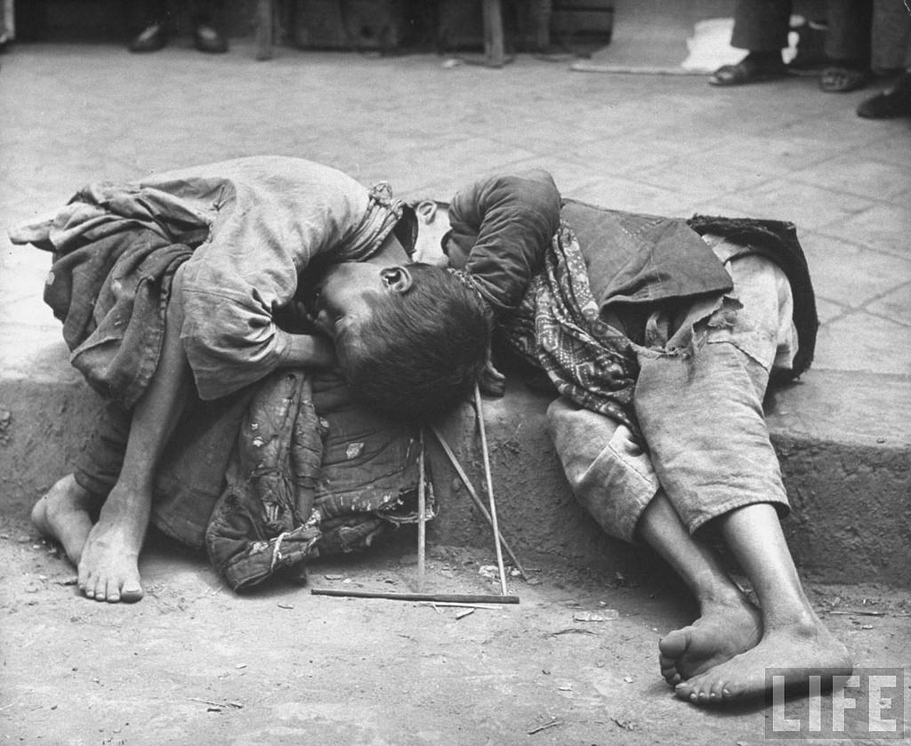
Historical Context of China’s One-Child Policy:
The Great Famine
1959-1961
Considered one of the greatest human-caused disasters in history
15-55 million people die
Notes:
Teacher Notes: (2) Another major factor that contributed to the Chinese government’s decision to adopt the one-child policy was the Great Famine, which occurred between the years of 1959-1961. It is considered one of the greatest human-caused disasters (i.e., it was not a natural disaster, but was caused by human decisions and policies related to China’s “Great Leap Forward” program, such as uneven food distribution, ordering farmers to switch to steel and iron production, etc. The famine ended up killing between 15-55 million people).

Slide 4
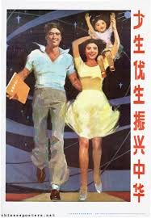
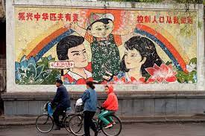
Propaganda for China’s One-Child Policy
Notes:
Teacher Notes: These two major factors were the impetus for China’s enactment of the one-child policy in 1979. This policy stated that families could only have one child. In addition to propaganda, the one-child policy was enforced through economic penalties (fines) and coercion (forced sterilization and forced abortion). The policy was also modified several times. For example in the mid-1980s, the policy was modified to allow couples in rural areas to have a second child if their first child was a girl.

Slide 5
What might be some objections about China’s one-child policy?
Notes:
Teacher Notes: The teacher will want to prompt students’ thinking and ask them to reflect on and discuss the potential ethical problems with China’s one-child policy. This question could be addressed in a number of ways: students could break into pairs for a few minutes to discuss and then report back to the class (Pair and Share) or the teacher could directly solicit student responses. The goal of the discussion is to begin to contextualize the math by activating student interest in the ethical/moral dimensions of the one-child policy.

Slide 6
Catholic Teaching on Population Control
Role of the government
Dignity of the human person
Notes:
Teacher Notes: Based on student responses, the teacher will want to transition to a brief consideration of some of the ethical considerations of the one-child policy, saying something like, “As you’ve noted China’s one-child policy, is not simply a matter of mathematical accuracy; it also has ethical implications that range from the proper role of the government to personal freedom to the dignity of human life. These are deep philosophical questions about the meaning and value of human life, so it’s not surprising that the Catholic Church has wisdom to offer to the conversation.”

Slide 7
Role of the Government
Open to Page 12 of your Packet!
“In the Catholic tradition, government has a positive role because of its responsibility to serve the common good, provide a safety net for the vulnerable, and help overcome discrimination and ensure equal opportunity for all. Government has inescapable responsibilities toward those who are poor and vulnerable, to ensure their rights and defend their dignity. Government action is necessary to help overcome structures of injustice and misuse of power and to address problems beyond the reach of individual and community efforts. Government must act when these other institutions fall short in defending the weak and protecting human life and human rights.”
  How does this quote describe the role of the government?
  What are some key words the bishops use to describe the role of the government?
  Based on this quote, can you brainstorm some concrete examples of things a government might be expected to do or not to do?
Source: “A Place at the Table: A Catholic Recommitment to Overcome Poverty and Respect the Dignity of All God’s Children,” U.S. Conference of Catholic Bishops (USCCB), 2002.
Notes:
Teacher Notes: This work corresponds to page 12 of the student packet.
The teacher may want to read the quote aloud and give students a few moments to process the quote. Then the teacher should ask students to identify key roles of the government.

Slide 8
Role of the Government
Open to Page 12 of your Packet!
Serve the common good (the flourishing of all people!)
Care for the poor and vulnerable
Overcome structures of injustice
Ensure equal opportunity for human flourishing
Protect human life and defend human dignity of all
Notes:
Teacher Notes: This work corresponds to page 12 of the student packet.
Beginning with the role of the government, the teacher should highlight that governments have a positive role to play in society. At a minimum, students should identify the following - Governments have a responsibility to:
Serve the common good (the flourishing of all people!)
Protect basic rights such as access to education, food, water, housing, healthcare, freedom of religion, dignified work, a living wage, etc.
Governments cannot promote the good of most individuals by sacrificing the good of others.
Care for the poor and vulnerable
Overcome structures of injustice
Governments have the responsibility to protect people from injustices, discrimination, and abuse of powers.
Ensure equal opportunity for human flourishing
The government has a responsibility to address problems that cannot be addressed by individuals or communities. Notice that this means the government does not control everything, but it does have the important role of maintaining the conditions for all human beings to flourish.
Protect human life and defend human dignity of all
How a government fulfills its responsibilities may vary depending on the time period, the place, the culture, etc., but all governments have the responsibility (duty) to promote human life, defend human dignity, and ensure the necessary conditions for all human beings to flourish. Although human dignity is only named in the fifth point, all of these responsibilities are based on the inherent dignity of the human person.
The teacher should then transition the class to a discussion on human dignity. The teacher may say something like: “We hear many different ideas about dignity, so let’s clarify exactly what the Catholic Church means by dignity and think about how it specifically relates to China’s one-child policy.”

Slide 9
Human Dignity
Open to Page 13 of your Packet!
“Man [all human beings] alone is called to share, by knowledge and love, in God’s own life . . . This is the fundamental reason for his dignity. Being in the image of God, the human individual possesses the dignity of a person, who is not just something, but someone…He is capable of self-knowledge, of self-possession and of freely giving himself and entering into communion with other persons. Further, he is called by grace to a covenant with his Creator, to offer him a response of faith and love that no other creature can give in his stead.”
  What words or phrases catch your attention?
  How does this quote describe human beings?
  What does it mean to be a someone rather than a something?
  With whom are we called to be in relationship? What does this quote imply about what our relationships should look like?
Source: Catechism of the Catholic Church, Libreria Editrice Vaticana, 1997, §356-57.
Notes:
Teacher Notes: This work corresponds to page 13 of the student packet.
The teacher can display and/or read the quote for the students and then begin to work through the questions.
What words or phrases catch your attention? (Give students an opportunity to sit a bit with the text and offer their thoughts.)
How does this quote describe human beings?
There are many different points students may raise from reading the text. All of these points speak to the uniqueness of the human person, from the rest of the created world, and thus the dignity of the human person.
This quote starts off saying that “man” is called to share in God’s life. This sharing in God’s life is a sharing in the knowledge of God and a sharing of love between God and the human person.
The quote says that the human person is created in the image of God. We believe that God is one God and also is a communion of persons, Father, Son, and Holy Spirit. This is what we mean when we say we believe in the Trinity. As human persons created in the image of God, we are created to be in loving communion with one another and with God.
The human person is capable of self-knowledge, of knowing himself or herself. Humans can reflect on their actions, feelings, motivations, choices, etc. Given this unique ability to reflect on and know oneself, the human person is thus able to freely enter into relationship with other persons.
As the students start to name what is means to be a human person, the teacher should naturally lead to the next question that asks what it means to be a human person as compared to the rest of the created world (i.e., someone rather than something).
What does it mean to be a someone rather than a something? (The teacher will want to guide students to the conclusion that human beings, no matter who they are, are never simply objects that can be used or disposed of – they are not things (like the chair students are sitting or the desk they’re working on). They are distinct from mere objects and can never be used as means to an end.)
With whom are we called to be in relationship and what does quote imply about what our relationships should look like? The quote specifically names God and others. The teacher might ask students to offer suggestions about types of relationships they have (siblings, parents, friends, etc.). The quote doesn’t explicitly say what our relationships should look like. This gives students the opportunity to think critically about what is implied in the text. The teacher will want to lead students to recognize the following features of human relationships: love, self-gift, commitment, communion, respect, honor, and care. etc.)

Slide 10
Human Dignity
Open to Page 14 of your Packet!
“If we really believe that we are temples of the Holy Spirit, that we are vessels of the Divine, and icons of the Trinity, that, when God the Father looks at us, he sees the face of his Son, Jesus, can you imagine how differently we would treat ourselves and other people? That is morality, is it not?”
  How does this quote describe human beings?
  How would we treat people if we really believed this?
Source: “The Dignity of the Human Person in Catholic Doctrine,” by Cardinal Dolan, Church Life Journal.
Notes:
Teacher Notes: This work corresponds to page 14 of the student packet.
Transitioning from the previous slide about human dignity to the next slide about the ethical commitments that human dignity binds us to, take a moment to pause on this quote from Cardinal Dolan’s address at the University of Notre Dame in 2013. Depending on the timing of the lesson, the teacher may want to unpack it with students (#1 & #2) or, if pressed for time may simply read the quote and skip to the summative statement (#3).
How does this quote describe human beings?
“temples of the Holy Spirit”
“vessels of the Divine”
“Icons of the Trinity”
“Reflections of God”
“Created in the image and likeness of God”
The teacher emphasize that we have a unique value or worth as human beings because we are created in the image of God and called to share in God’s own life. Not only can we know and love God, BUT God loves each and every person and wants to bring every person to the fullness of life.
The teach may also want to ask what this quote says about morality?
“How we treat ourselves and other people.”
“It’s what we ought to do based on the truth about the human person (i.e., what is).”
The teacher will want to emphasize that morality isn’t just a list of dos and don’ts, but is most fundamentally about our relationship with God, others, and ourselves.
The teacher should conclude by saying something like:
If we really believe that the Holy Spirit dwells within us (and all human beings) and that we vessels of the Divine, this will have important implications for how we treat ourselves and others. Related to the topic we’re studying, we can say that “if the pre-born baby in the womb, from the earliest moments of his or her conception, is a human person—an is that comes, not from the Catechism but from the biology textbook used by any sophomore in high school—then that baby’s life ought to be cherished and protected.”
(https://churchlifejournal.nd.edu/articles/the-dignity-of-a-human-person-a-catholic-doctrine/)

Slide 11
Consequences of Human Dignity
Open to Page 14 of your Packet!
“Whatever is opposed to life itself, such as any type of murder, genocide, abortion, euthanasia or wilful self-destruction, whatever violates the integrity of the human person, such as mutilation, torments inflicted on body or mind, attempts to coerce the will itself; whatever insults human dignity, such as subhuman living conditions, arbitrary imprisonment, deportation, slavery, prostitution, the selling of women and children; as well as disgraceful working conditions, where men are treated as mere tools for profit, rather than as free and responsible persons; all these things and others of their like are infamies indeed. They poison human society, but they do more harm to those who practice them than those who suffer from the injury. Moreover, they are supreme dishonor to the Creator.”
Source: Gaudium et Spes (Joy and Hope): Pastoral Constitution on the Church in the Modern World, Pope Paul VI, 1965, §27.
Notes:
Teacher Notes: This work corresponds to page 14 of the student packet.
If time permits, the teacher can display the final quote from Gaudium et Spes (Joy and Hope): Pastoral Constitution on the Church in the Modern World, and share that because each human being has dignity, they cannot be treated in ways that violate their dignity. There are no accompanying questions for this quote. The teacher may wish only to display the quote for students to read or ask students about their reactions to this quote. This will depend on the discussion up to this point and the amount of class time that is left for the day.

Slide 12
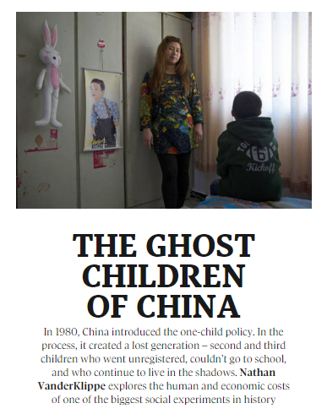
Unintended Consequences of the One-Child Policy
Aging population
Gender imbalances, esp. in countries where there is a preference for male children
Undocumented children
Notes:
Teacher Notes: The teacher concludes the lesson by explaining that apart from the moral and ethical issues of China’s one-child policy, there were also unintended consequences. Today, China has too few younger people to support its aging population. Given the cultural preference for males, the country also suffers from severe gender imbalance. There is also a large population of undocumented children (i.e., those born illegally under the one-child policy). For homework, students will read more about some of the unintended consequences of China’s one-child policy. The teacher may encourage students to consider the points discussed in class and how they relate to the article they will be reading for homework.

