Slide 1
Evaluating the One-Child Policy
Exploring China’s One-Child Policy

Slide 2
Quiz
Evaluate the following expression. Round your answer to the nearest tenth.
    40(1+0.2)²³⁻¹⁰
      40(1.02)²³⁻¹⁰
      40(1.02)¹³
      40(1.29)
      51.7

Slide 3

Quiz
Algebraically solve the following equation for x. Round your answer to the nearest tenth.
    52 = 13(2.05)^{x}
      $\left(\frac{52}{13}\right)={2.05}^{x}$
      $x=\log_{2.05}\left(\frac{52}{13}\right)$
      $x=1.9$

Slide 4
Quiz
The following three questions are all based on Capital City, USA. The population of Capital City in 2000 was 3,271. The city was growing at a rate of 1.19%.
Write an exponential function that models population P as a function of year t.
          P(t) = 3271(1+0.0119)^{t-2000}

Slide 5
Quiz
The following three questions are all based on Capital City, USA. The population of Capital City in 2000 was 3,271. The city was growing at a rate of 1.19%.
Use this model to predict the population of Capital City, USA in 2020.
          P(2020) = 3271(1+0.0119)²⁰²⁰⁻²⁰⁰⁰
          P(2020) = 3271(1.0119)²⁰²⁰⁻²⁰⁰⁰
          P(2020) = 3271(1.0119)²⁰
          P(2020) = 3271(1.27)
          P(2020) = 4,154

Slide 6

Quiz
The following three questions are all based on Capital City, USA. The population of Capital City in 2000 was 3,271. The city was growing at a rate of 1.19%.
Use this model to estimate the year in which the population of Capital City, USA will reach 5,000.
      $$5,000=3,271{(1+0.0119)}^{t−2000}$$
      $$5,000=3,271{(1.0119)}^{t−2000}$$
      $$\left(\frac{5,000}{3,271}\right)={\left(1.0119\right)}^{t−2000}$$
      $$t−2000= \log_{1.0119}\left(\frac{5,000}{3,271}\right)$$
      $t=2000+\log_{1.0119}\left(\frac{5,000}{3,271}\right)$
      $t=2035.9$
During 2035

Slide 7
Quiz
Explain how you arrived at your answer to #5. (This explanation can include an explanation of your computation as well as any rounding that may have happened.)
  A strict calculation will yield 2035.9. This means that the population will reach 5,000 during the year 2035; you cannot just round to the nearest whole number.

Slide 8
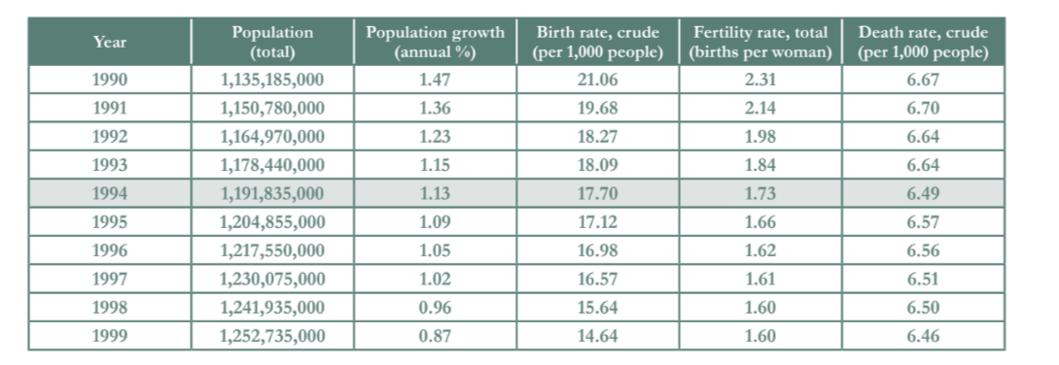
Evaluating the One-Child Policy
Open to Page 17 of your Packet!
One of the original goals of the scientists and data analysts was to keep China’s population below 1.2 billion. They did not meet this goal. According to the table below, in what year did the Chinese population actually reach 1.2 billion?
Notes:
Teacher Notes: This work corresponds to page 17 of the student packet.

Slide 9
Evaluating the One-Child Policy
Open to Page 17 of your Packet!
One of the original goals of the scientists and data analysts was to keep China’s population below 1.2 billion. They did not meet this goal. According to the table below, in what year did the Chinese population actually reach 1.2 billion?
During 1994
Notes:
Teacher Notes: This work corresponds to page 17 of the student packet.
Problem 14 reminds students that one of the original goals of the scientists in their data analysis from the 1970s was to keep China's population below 1.2 billion. As history revealed, China did not meet this goal.

Slide 10
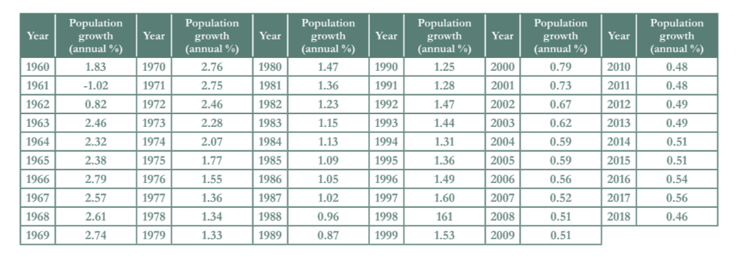
Evaluating the One-Child Policy
Open to Page 17 of your Packet!
How close was your prediction in #11 based on the 1978-data-informed model? What does this tell you about the average population growth rate between 1978 and the year in which the population reached 1.2 billion? Confirm this using the data from the table above.
Notes:
Teacher Notes: This work corresponds to page 17 of the student packet.
Notice the negative growth rate for the nation in 1961. This may be a good time to remind students about the great Chinese famine which caused a significant drop in the population. This table can be used to help students reflect on what they noticed in #14 and earlier in the week.

Slide 11
Evaluating the One-Child Policy
Open to Page 17 of your Packet!
How close was your prediction in #11 based on the 1978-data-informed model? What does this tell you about the average population growth rate between 1978 and the year in which the population reached 1.2 billion? Confirm this using the data from the table above.
The prediction was very close. This tells me that the average population growth rate between 1978 and 1994 was very similar to the population growth rate in 1978 (1.34). Finding a mean average of these growth rates confirms this.
Notes:
Teacher Notes: This work corresponds to page 17 of the student packet.
Students should be able to recognize that the average growth rate didn't really change from 1978 to 1994 or in other words that the average population birth rate between 1978 and 1994 was the same. The fact that the population growth rate was still basically the same for roughly the next 15 years seems to imply that even with the one-child policy the population growth rate remained relatively consistent.

Slide 12
Evaluating the One-Child Policy
Open to Page 18 of your Packet!
China’s population growth rate is in decline.
  Using “year” as the x-value and “population growth” as the y-value, create a linear function to model the population growth rate. You will need to use an external tool (Excel, Desmos, graphing calculator, etc.) to find a line of best fit to use for the linear model.
  Using this model, estimate the year in which China’s growth rate will reach 0%.
Notes:
Teacher Notes: This work corresponds to page 18 of the student packet.

Slide 13
Evaluating the One-Child Policy
Open to Page 18 of your Packet!
China’s population growth rate is in decline.
  Using “year” as the x-value and “population growth” as the y-value, create a linear function to model the population growth rate. You will need to use an external tool (Excel, Desmos, graphing calculator, etc.) to find a line of best fit to use for the linear model.
  Using this model, estimate the year in which China’s growth rate will reach 0%.
r(t) = -0.0325t + 65.939
The population growth rate will be zero in 2028. Indeed, most public models estimate that China will reach zero population growth around 2030.
Notes:
Teacher Notes: This work corresponds to page 18 of the student packet.

Slide 14
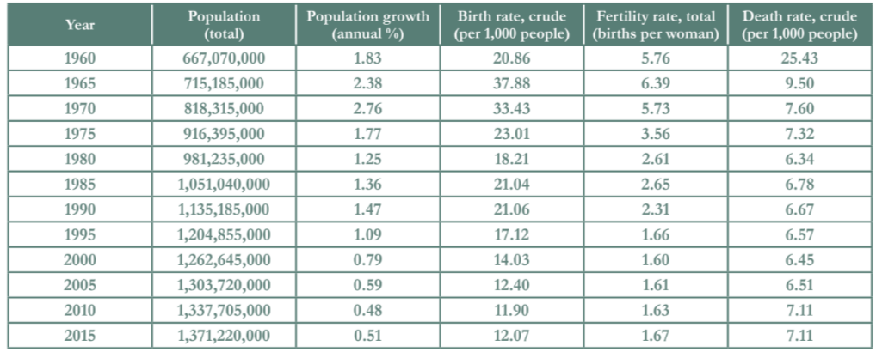
Evaluating the One-Child Policy
Open to Page 18 of your Packet!
From what you have learned, did the one-child policy significantly limit the growth of the Chinese population? Why or why not? You may use the table below to inform your response.
Notes:
Teacher Notes: This work corresponds to page 18 of the student packet.
Question #17 is a little bit more open. It is not a simple calculation or reading but rather encourages the students to think a little bit more. The table provided has a variety of different data points for students to consider. This question provides a good hinge point for the teacher to bring the students’ awareness back to the fact that numbers in this context are not just data points empty of meaning but actually stand for real human lives. It is important to bring back this thread for students–that they need to consider the meaning of the numbers, what the numbers represent. It’s important to humanize the numbers and not just look at things as a simple calculation.

