Slide 1
Analyzing the Mathematical Models of China’s One-Child Policy
Exploring China’s One-Child Policy

Slide 2
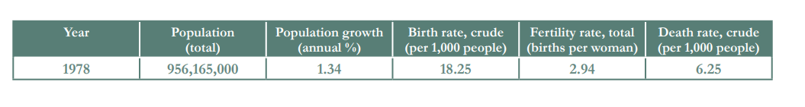
Development of the One-Child Policy
Open to Page 9 of your Packet!
The year is 1979, and you are a data analyst preparing a report regarding future projections of the Chinese population using an exponential model. Solve the following equations for x. Round to the nearest tenth.
You are using data from the previous year (1978) to make your projections.
Build an exponential model based on this data for China’s population (P) as a function of the year (t).
Notes:
Teacher Notes: This work corresponds to page 9 of the student packet.
The teacher may want to ask students what year the data is from and why they think the data is from 1978. Some students may think the data should be from 1979 if they are in the year 1979. This can be a good opportunity to draw students’ attention to the meaning of the numbers being used. If we are currently in the year 1979, then we would not yet have numbers for the population of China in 1979. If officials were to use numbers from the 1960s, while the population numbers would be accurate for those years, the growth rate may have shifted by the late 1970s.

Slide 3
Development of the One-Child Policy
Open to Page 9 of your Packet!
The year is 1979, and you are a data analyst preparing a report regarding future projections of the Chinese population using an exponential model. Solve the following equations for x. Round to the nearest tenth.
You are using data from the previous year (1978) to make your projections.
Build an exponential model based on this data for China’s population (P) as a function of the year (t).
  P(t) = 956,165,000(1+0.0134)^{t-1978}
Notes:
Teacher Notes: This work corresponds to page 9 of the student packet.

Slide 4
Development of the One-Child Policy
Open to Page 9 of your Packet!
  P(t) = 956,165,000(1+0.0134)^{t-1978}
Use your model to estimate China’s population in the following years:
  2000
  2040
  2080
Notes:
Teacher Notes: This work corresponds to page 9 of the student packet.

Slide 5
Development of the One-Child Policy
Open to Page 9 of your Packet!
  P(t) = 956,165,000(1+0.0134)^{t-1978}
Use your model to estimate China’s population in the following years:
  2000
  2040
  2080
  P(2000) = 956,165,000(1+0.0134)²⁰⁰⁰⁻¹⁹⁷⁸
  P(2000) = 956,165,000(1.0134)²⁰⁰⁰⁻¹⁹⁷⁸
  P(2000) = 956,165,000(1.0134)²²
  P(2000) = 1,281,482,387
Notes:
Teacher Notes: This work corresponds to page 9 of the student packet.

Slide 6
Development of the One-Child Policy
Open to Page 9 of your Packet!
  P(t) = 956,165,000(1+0.0134)^{t-1978}
Use your model to estimate China’s population in the following years:
  2000
  2040
  2080
  P(2040) = 956,165,000(1+0.0134)²⁰⁴⁰⁻¹⁹⁷⁸
  P(2040) = 956,165,000(1.0134)²⁰⁴⁰⁻¹⁹⁷⁸
  P(2040) = 956,165,000(1.0134)⁶²
  P(2040) = 2,182,471,794
Notes:
Teacher Notes: This work corresponds to page 9 of the student packet.

Slide 7
Development of the One-Child Policy
Open to Page 9 of your Packet!
  P(t) = 956,165,000(1+0.0134)^{t-1978}
Use your model to estimate China’s population in the following years:
  2000
  2040
  2080
  P(2080) = 956,165,000(1+0.0134)²⁰⁸⁰⁻¹⁹⁷⁸
  P(2080) = 956,165,000(1.0134)²⁰⁸⁰⁻¹⁹⁷⁸
  P(2080) = 956,165,000(1.0134)¹⁰²
  P(2080) = 3,716,932,188
Notes:
Teacher Notes: This work corresponds to page 9 of the student packet.

Slide 8
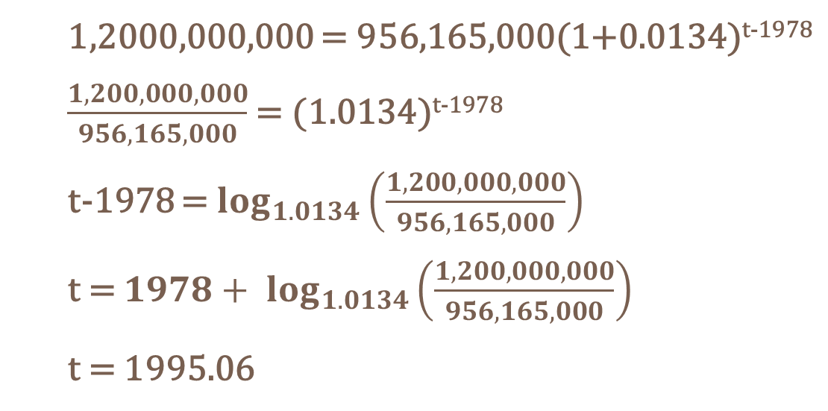
Development of the One-Child Policy
Open to Page 10 of your Packet!
  P(t) = 956,165,000(1+0.0134)^{t-1978}
The team of scientists and other analysts claimed that the population of China needed to be kept under 1.2 billion in order to avoid mass starvation and country-wide disaster. Use your model to predict the year in which the Chinese population would reach 1.2 billion.
  1,2000,000,000 = 956,165,000(1+0.0134)^{t-1978}
  $\frac{1,200,000,000}{956,165,000}$= (1.0134)^{t-1978}
  t-1978 = $\log_{1.0134}\left(\frac{1,200,000,000}{956,165,000}\right)$
  t = ${1978+ log}_{1.0134}\left(\frac{1,200,000,000}{956,165,000}\right)$
  t = 1995.06
  According to this model, the population would reach 1.2 billion in 1995.
Notes:
Teacher Notes: This work corresponds to page 10 of the student packet.

Slide 9
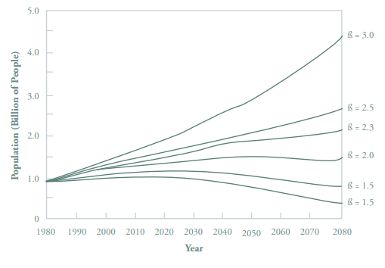
Development of the One-Child Policy
Open to Page 10 of your Packet!
Chinese scientists built complex models to make the same types of projections. Below is a graph of one of the projections used by the Chinese government before instituting its one-child policy.
  In this graph, ß represents the total fertility rate (number of births per woman).
Which of the values of ß found on the graph most closely matches the total fertility rate from 1978?
3.0 (In 1978, it was 2.94.)
  Source: Song Jian Li Guangyuan, “Renko fazhan wenti dingliang yanju” (“Quantitative research on the problem of population development”) Jingi yanjiu (Economy Research), No. 2, pp 60-67. Reproduced in Greenhalgh, “Science, Modernity, p.180.
Notes:
Teacher Notes: This work corresponds to pages 10-11 of the student packet.

Slide 10
Development of the One-Child Policy
Open to Page 10 of your Packet!
Chinese scientists built complex models to make the same types of projections. Below is a graph of one of the projections used by the Chinese government before instituting its one-child policy.
  In this graph, ß represents the total fertility rate (number of births per woman).
Which of the values of ß found on the graph most closely matches the total fertility rate from 1978?
3.0 (In 1978, it was 2.94.)
  Source: Song Jian Li Guangyuan, “Renko fazhan wenti dingliang yanju” (“Quantitative research on the problem of population development”) Jingi yanjiu (Economy Research), No. 2, pp 60-67. Reproduced in Greenhalgh, “Science, Modernity, p.180.
Notes:
Teacher Notes: This work corresponds to pages 10-11 of the student packet.

Slide 11
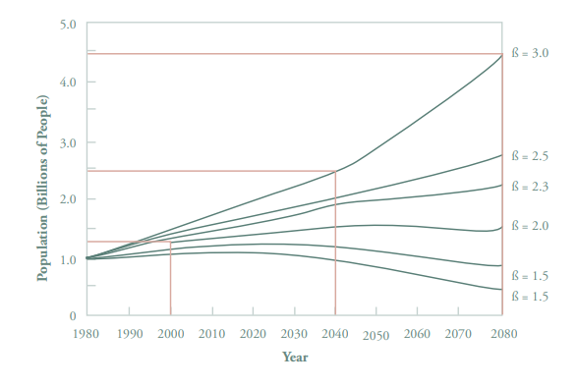
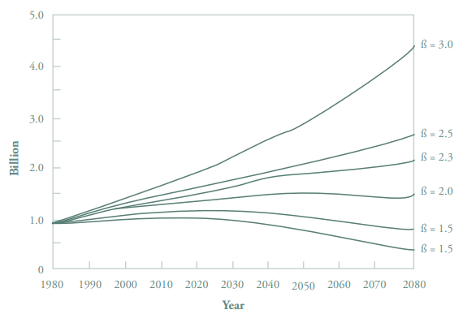
Development of the One-Child Policy
Open to Page 11 of your Packet!
b) Use the graph’s projection for this ß-value to make estimates of China’s population in the following years:
1. 2000 1.3 billion
2. 2040 2.4 billion
3. 2080 4.3 billion
  In this graph, ß represents the total fertility rate (number of births per woman).
  Source: Song Jian Li Guangyuan, “Renko fazhan wenti dingliang yanju” (“Quantitative research on the problem of population development”) Jingi yanjiu (Economy Research), No. 2, pp 60-67. Reproduced in Greenhalgh, “Science, Modernity, p.180.
Notes:
Teacher Notes: This work corresponds to pages 10-11 of the student packet.

Slide 12
Development of the One-Child Policy
Open to Page 11 of your Packet!
b) Use the graph’s projection for this ß-value to make estimates of China’s population in the following years:
c) How close are the above estimates to your calculations from #10?
1. 2000 1.3 billion
2. 2040 2.4 billion
3. 2080 4.3 billion
The estimates from #10 were very close but were slightly lower because the fertility rate in 1978 was slightly below 3.0 and the model used in the chart above does not appear to be a perfectly exponential curve.
Notes:
Teacher Notes: This work corresponds to pages 10-11 of the student packet.

Slide 13
Development of the One-Child Policy
Open to Page 11 of your Packet!
The group of researchers that created the graph above believed the “ideal” population size of China in 2080 was between 650 million and 700 million people. Based on the projection in the graph shown above, what would the total fertility rate (number of births per woman) need to be in order to achieve this target population?
Notes:
Teacher Notes: This work corresponds to pages 10-11 of the student packet.

Slide 14
Development of the One-Child Policy
Open to Page 11 of your Packet!
The group of researchers that created the graph above believed the “ideal” population size of China in 2080 was between 650 million and 700 million people. Based on the projection in the graph shown above, what would the total fertility rate (number of births per woman) need to be in order to achieve this target population?
It would need to be between 1.0 and 1.5.
Notes:
Teacher Notes: This work corresponds to pages 10-11 of the student packet.
This problem establishes the “need” for a one-child policy. The problem sets the stage for a student to come to the conclusion that a β-value between 1.0 and 1.5 would be necessary to achieve the population goal.

Slide 15
Based on what you have learned so far, what do you think some ethical objections to China’s one-child policy might be?
Notes:
Teacher Notes: In order to prepare students to consider the ethical implications of China’s one-child policy, the teacher should conclude by inviting students to review their collective input on the question they answered at the close of Lesson #2. “Based on what you have learned so far, what do you think some ethical objections to China’s one-child policy might be?”

