Slide 1
Introduction and Review of Exponential Functions
Exploring China’s One-Child Policy

Slide 2
Preliminary Problem
Open to Page 2 of your Packet!
There are 103 students in the senior high school class. They are planning a class trip to the zoo. Only 25 students can fit on a bus. How many buses does the principal need to arrange to get all of the students to the zoo?
    3.12
    4
    4.12
    5
Notes:
Teacher Notes: This work corresponds to pages 2 of the student packet.

Slide 3
Preliminary Problem
Open to Page 2 of your Packet!
There are 103 students in the senior high school class. They are planning a class trip to the zoo. Only 25 students can fit on a bus. How many buses does the principal need to arrange to get all of the students to the zoo?
    3.12
    4
    4.12
    5
Correct answer: 5 (d)
Fractions of buses do not have any contextual meaning.
Notes:
Teacher Notes: This work corresponds to pages 2 of the student packet.

Slide 4
In this unit…
you will explore the mathematics behind China’s one-child policy.
you will engage in a moral consideration of China’s one-child policy.
you will consider the role mathematics should play in ethical and policy decisions.
Notes:
Teacher Notes: This is an important opportunity to orient students’ minds and to encourage them to approach this unit with an openness to new ideas and critical thought. This unit presents opportunities to use “real-world math,” not simply fabricated problems.

Slide 5
Overview of this Unit
Day 1: Introduction and Review of Exponential Functions
Day 2: Review of Logarithmic Functions and “War”
Day 3: Development of China’s One-Child Policy
Day 4: Quiz / Moral Consideration of China’s One-Child Policy
Day 5: Evaluating China’s One-Child Policy
Notes:
Teacher Notes: Pass out the student packets before or after you walk students through a basic outline of the coming days.

Slide 6
PBS RetroReport: “The Population Bomb”
What is the new kind of fear that began to spread in the 1960s?
Describe the sources of this new fear?
What is zero population growth (ZPG)?
What techniques did advocates push in order to decrease the birth rate?
Why did India’s elite think the poor were poor? What other reason does the speaker give that might be why the poor are poor?
According to the video, why aren’t insect models appropriate for modeling human populations?
How has the shift towards urbanization and the rise of the green revolution impacted family size?
Notes:
Teacher Notes: Students may want to write down answers in their packet during the video, or it may be more helpful to let them watch the video and then answer the questions together as a class afterwards.

Slide 7
PBS RetroReport: “The Population Bomb”
What is the new kind of fear that began to spread in the 1960s?
  Rampant population growth which will lead to mass starvation, mass pollution, social conflicts, crime…
Describe the sources of this new fear?
  Paul Ehrlich and his book Population Bomb published in 1968
What is zero population growth (ZPG)?
  when the birth rate is equal to the death rate, so the total population remains constant
What techniques did advocates push in order to decrease the birth rate?
  Couples voluntarily reducing the number of children in a given marriage, compulsion from the government including taxes on people who have more children, blacklisting people, companies, and organizations impeding population control, responsibility prizes for childless marriages, luxury taxes on cribs, diapers, expensive toys, etc., sterility drugs put in water sources.
Notes:
Teacher Notes:

Slide 8
PBS RetroReport: “The Population Bomb” cont.
Why did India’s elite think the poor were poor? What other reason does the speaker give that might be why the poor are poor?
  India’s elite thought the poor were poor because they had too many children. The speaker suggests that the poor were poor because of an unfair and unequal economic system.
According to the video, why aren’t insect models appropriate for modeling human populations?
  Human beings are conscious beings and do all kinds of things to change our destiny
How has the shift towards urbanization and the rise of the green revolution impacted family size?
  As families move into urban areas and away from farming, parents don’t need as many children to help with a farm. Focus has shifted to the education of children, and many families are naturally choosing to have fewer children. With advances in farming there is also more food available for children.
Notes:
Teacher Notes:

Slide 9
Review Problems
Open to Page 3 of your Packet!
Without a calculator, evaluate the following expressions.
  3²
  2⁴
  (1+3)²
  2(1+1)³
Notes:
Teacher Notes: This work corresponds to page 3 of the student packet.
Remind students about order of operations. It is vitally important when performing these calculations!

Slide 10
Review Problems
Open to Page 3 of your Packet!
Without a calculator, evaluate the following expressions.
  3² = 9
  2⁴ = 16
  (1+3)² = (4)² = 16
  2(1+1)³ = 2(2)³ = 2(8) = 16
Notes:
Teacher Notes: This work corresponds to page 3 of the student packet.
Remind students about order of operations. It is vitally important when performing these calculations!

Slide 11
Review Problems
Open to Page 3 of your Packet!
With a calculator, evaluate the following expressions.
  2.51³
  (1+0.02)²³
  563(1+0.015)²⁰²⁰⁻¹⁹⁷⁹
  What rounding would be expected if these were monetary units?
  What rounding would be expected if these were humans?
Notes:
Teacher Notes: This work corresponds to page 3 of the student packet.
The rounding present for #2 in the review problems is a good opportunity to pose some ”what-if” questions for students:
What rounding would be expected if these were monetary units? (nearest hundredth)
What rounding would be expected if these were human? (nearest integer)

Slide 12
Review Problems
Open to Page 3 of your Packet!
With a calculator, evaluate the following expressions. Round your answers to the nearest tenth.
  2.51³ = 15.8
  (1+0.02)²³ = (1.02)²³ = 16
  563(1+0.015)²⁰²⁰⁻¹⁹⁷⁹
  536(1.015)²⁰²⁰⁻¹⁹⁷⁹
  563(1.015)⁴¹
  1,036.6
  What rounding would be expected if these were monetary units?
    Nearest hundredth
  What rounding would be expected if these were humans?
    Nearest integer
Notes:
Teacher Notes: This work corresponds to page 3 of the student packet.
The rounding present for #2 in the review problems is a good opportunity to pose some ”what-if” questions for students:
What rounding would be expected if these were monetary units? (nearest hundredth)
What rounding would be expected if these were human? (nearest integer)

Slide 13
Review of Exponential Equations
Exploring China’s One-Child Policy
Notes:
27:35

Slide 14
Today’s Class
What is exponential growth?
What is the structure of an exponential equation?
What is a simple exponential function that can be used to model population growth?

Slide 15
What is Exponential Growth?
Open to Page 4 of your Packet!
Exponential growth is
  A type of growth in which the increase in size is directly proportional to the size of the current quantity.
What is the structure of an exponential equation?
What is a simple exponential function that can be used to model population growth?

Slide 16
What is the structure of an exponential equation?
y = a(b)^{x}
output
input
initial amount
base
If 0<b<1, the outputs will decrease (decay).
If b>1, the outputs will increase (growth).

Slide 17
What is a simple exponential function that can be used to model population growth?
P(t) = P₀(1+r)^{t-t0}
initial year
population in year t
year
population in the initial year
population growth rate
r is a percentage expressed in decimal form in this function.
  Ex: If the population growth rate is 2.3%, r=0.023.
If r<0, then 0<b<1 and the population is decreasing in size.
If r=0, then b=1 and the population is constant in size.
If r>0, then b>1 and the population is growing in size.
Notes:
Teacher Notes: There are several ways to model population growth, including some equations that involve e. For the sake of continuity, this structure will be used consistently.

Slide 18
Practice Problems
Open to Page 4 of your Packet!
Without a calculator, evaluate the following expressions.
  4²
  2(3+1)⁵⁻³
Notes:
Teacher Notes: This work corresponds to page 4 of the student packet. Depending on the time remaining in class, these problems (#3-5) can be small group problems or can be assigned as homework problems. The teacher resources assume that students successfully complete these problems in class, so if they do not, perhaps solutions should be shared with students to review before the next class.

Slide 19
Practice Problems
Open to Page 4 of your Packet!
Without a calculator, evaluate the following expressions.
  4²
  2(3+1)⁵⁻³
  4x4 = 16
  2(4)⁵⁻³
  2(4)²
  2(16) = 32
Notes:
Teacher Notes: This work corresponds to page 4 of the student packet.

Slide 20
Practice Problems
Open to Page 4 of your Packet!
The exponential population model for Anytown, USA is
P(t) = 200(1+0.032)^{t-1947}.
Without performing any calculations, answer the following questions.
  Written as a percentage, what is the growth rate?
    3.2%
  What does the number 200 represent?
      the population of Anytown, USE in 1947
  What would P91975) represent?
      the population of Anytown, USA in 1975
Notes:
Teacher Notes: This work corresponds to page 4 of the student packet.

Slide 21
Practice Problems
Open to Page 4 of your Packet!
The exponential population model for Anytown, USA is
P(t) = 200(1+0.032)^{t-1947}.
Without performing any calculations, answer the following questions.
  Written as a percentage, what is the growth rate?
    3.2%
  What does the number 200 represent?
      the population of Anytown, USA in 1947
  What would P91975) represent?
      the population of Anytown, USA in 1975
Notes:
Teacher Notes: This work corresponds to page 4 of the student packet.

Slide 22
Practice Problems
Open to Page 5 of your Packet!
In 1990, Whoville had a population of 2,000,000 residents. Its population growth rate was 0.45%.
  Create an exponential function to model the population of Whoville.
    P(t) = 2,000,000(1+0.0045)^{t-1990}
  Use your model to predict the population of Whoville in 2010.
      P(2010) = 2,187,907
Notes:
Teacher Notes: This work corresponds to page 5 of the student packet.

Slide 23
Practice Problems
Open to Page 5 of your Packet!
In 1990, Whoville had a population of 2,000,000 residents Its population growth rate was 0.45%.
  Create an exponential function to model the population of Whoville.
    P(t) = 2,000,000(1+0.0045)^{t-1990}
  Use your model to predict the population of Whoville in 2010.
      P(2010) = 2,000,000(1+0.0045)²⁰¹⁰⁻¹⁹⁹⁰
      P(2010) = 2,000,000(1.0045)²⁰¹⁰⁻¹⁹⁹⁰
      P(2010) = 2,000,000(1.0045)²⁰
      P(2010) = 2,187,907
Notes:
Teacher Notes: This work corresponds to page 5 of the student packet.

Slide 24
Practice Problems
Open to Page 5 of your Packet!
In 1990, Whoville had a population of 2,000,000 residents Its population growth rate was 0.45%.
  If Whoville sustained this population growth rate, in what year would Whoville reach 2,250,000? How did you find your answer?
Notes:
Teacher Notes: This work corresponds to page 5 of the student packet.

Slide 25
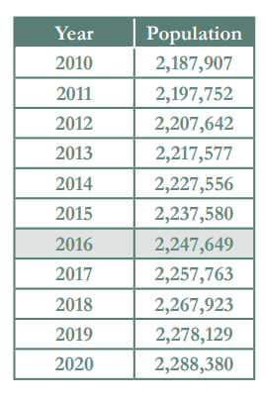
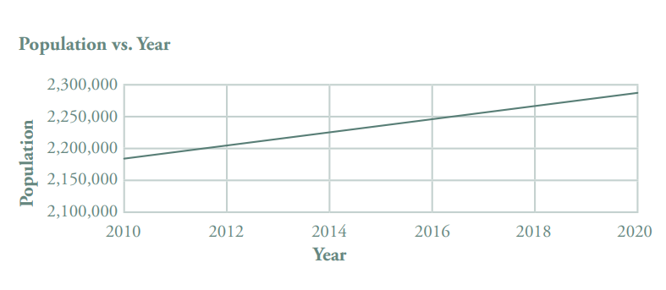
Practice Problems
Open to Page 5 of your Packet!
In 1990, Whoville had a population of 2,000,000 residents Its population growth rate was 0.45%.
  If Whoville sustained this population growth rate, in what year would Whoville reach 2,250,000? How did you find your answer?
  Whoville’s population would reach 2,250,000 in 2016. There are many ways to solve this problem, including with a graph, through algebra, and with a table.
Notes:
Teacher Notes: This work corresponds to page 5 of the student packet.

